Slide 1
Tourismo AI: Smart Travel & Hospitality Hub
PIP4004 Capstone Project
Review-2
Batch Number: CSE-G94
Roll Number | Student Name
20211CSE0525 | Hritik Kumar Soni
20211CSE0510 | Utkarsh Pandey
20211CSE0465 | Ashmit Kumar
Under the Supervision of,
Ms. Vineetha B
Professor / Associate Professor / Assistant Professor
School of Computer Science & Engineering
Presidency University

Slide 2
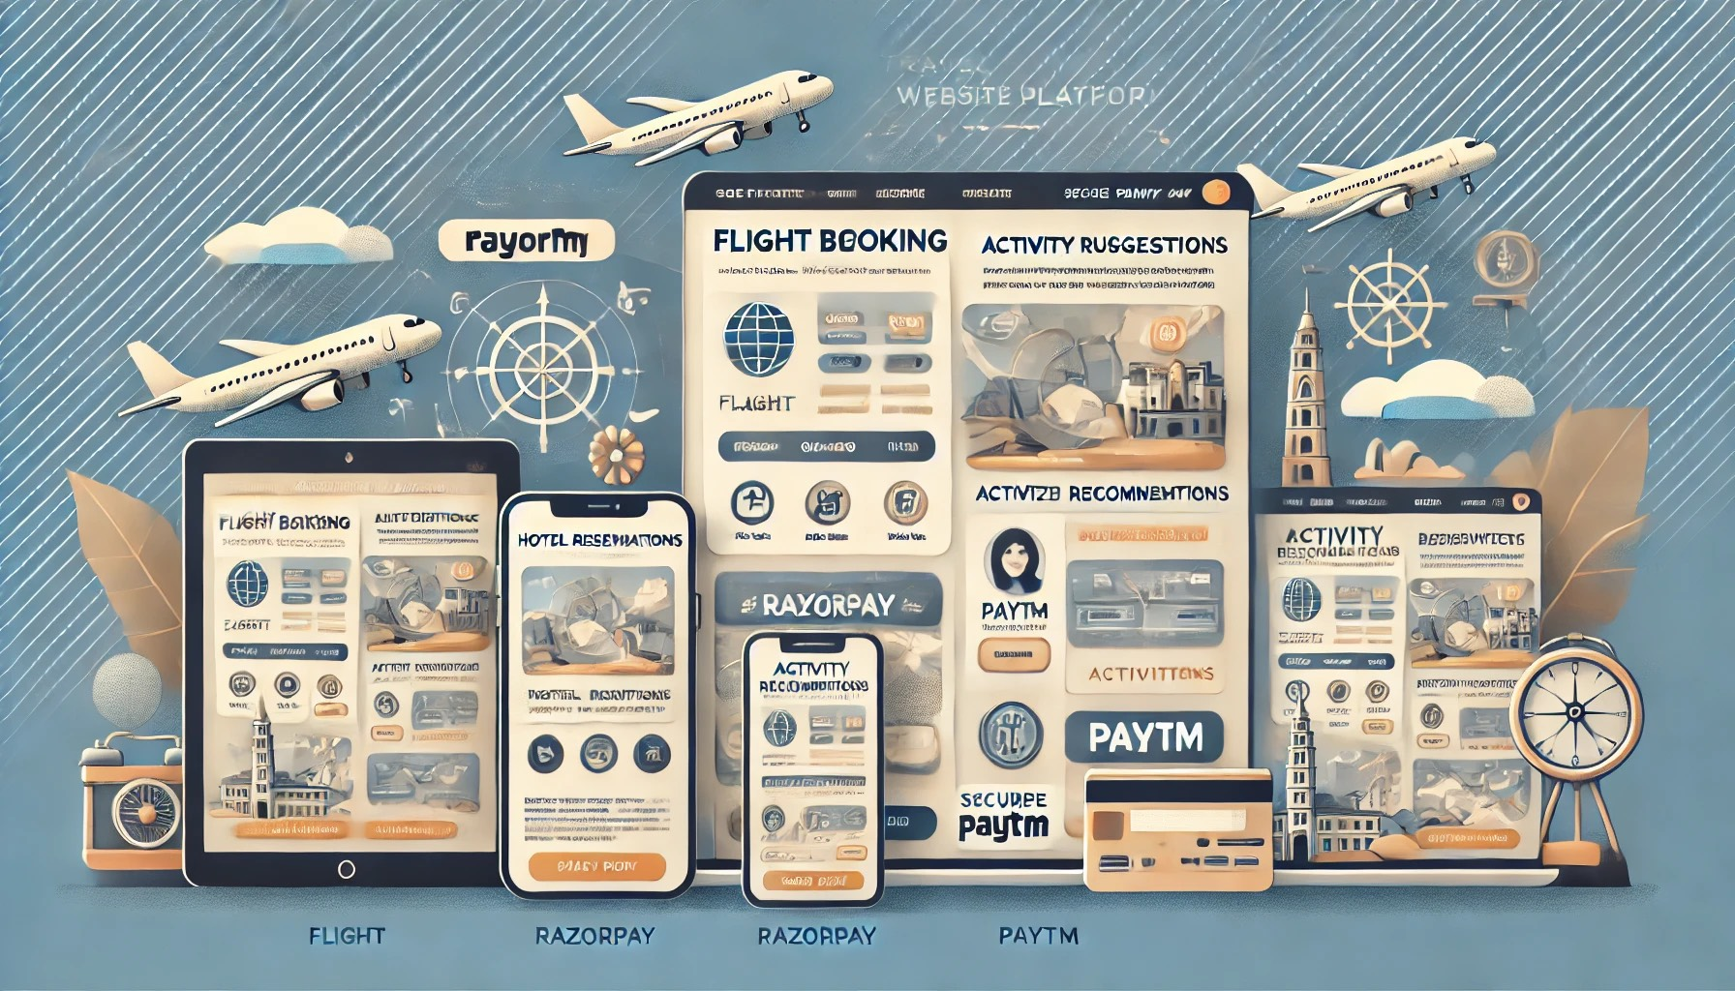
Introduction
"Tourismo AI: Smart Travel & Hospitality Hub,” website offer a comprehensive travel platform designed to simplify and enhance your travel planning experience. In an era where travel is an essential part of our lives, we recognize the challenges of navigating multiple platforms for flights, hotels, activities, and transportation. Our website centralizes all these services into one user-friendly interface, allowing you to plan your entire trip seamlessly.
At the heart of our platform lies advanced technology, including artificial intelligence, which provides personalized travel recommendations tailored to your preferences and past behaviors. Whether you’re looking for the best flight deals, unique accommodations, or exciting activities, our intelligent system curates options that suit your needs, making travel planning easier than ever.
With a focus on security and convenience, we offer integrated payment solutions that ensure safe transactions and multiple payment options. Additionally, our real-time notifications and 24/7 customer support keep you informed and supported at every step of your journey.

Slide 3
Literature Review
Centralized Travel Services: Many travel platforms currently operate in silos, requiring users to visit multiple websites for booking flights, hotels, and activities, leading to inefficiencies and frustration in the planning process.
Personalized Recommendations: AI and machine learning technologies are increasingly being utilized to provide personalized travel suggestions based on user preferences, past behaviors, and booking history, which significantly enhance the travel experience.
Streamlined Booking Process: Integrating services into a single platform allows for a more streamlined booking process, reducing the complexity associated with managing multiple reservations across different sites.
Real-Time Updates: Travel platforms that offer real-time notifications regarding flight status, booking confirmations, and itinerary changes help keep users informed and engaged throughout their journey.
Data Security and Privacy: With growing concerns about online transactions, it is crucial for travel platforms to implement robust security measures to protect users' personal and payment information, fostering trust and reliability.
User Engagement Issues: Many existing travel platforms struggle to maintain user engagement due to a lack of personalized content and limited interactive features that encourage users to return for planning future trips.
Limited Customization: Current solutions often offer a one-size-fits-all approach, failing to adapt to individual traveler needs and preferences, which can hinder user satisfaction and retention.
Fragmented User Experience: Users often face a fragmented experience when navigating different platforms, leading to confusion and dissatisfaction during the travel planning process.
Mobile Accessibility: With the increasing reliance on mobile devices for travel planning, it is essential for platforms to offer fully responsive designs that enhance usability on smartphones and tablets.
Comprehensive Travel Insights: There is a need for travel platforms that not only facilitate bookings but also provide insightful analytics on travel habits, preferences, and suggestions for future trips.

Slide 4
Existing method Drawback
Fragmented Travel Services: Many current travel platforms require users to navigate multiple websites for booking flights, hotels, and activities, leading to a disjointed experience that can be confusing and time-consuming.
Generic Recommendations: Existing recommendation systems often rely on basic algorithms that provide generic travel suggestions, lacking personalization based on individual user preferences, behaviors, and past bookings.
Complex Booking Processes: Users frequently encounter complicated booking processes that require filling out repetitive forms and managing multiple reservations across different sites, resulting in frustration and potential errors.
Limited Real-Time Information: While some platforms offer real-time tracking, many fail to provide timely updates on flight statuses, booking confirmations, and itinerary changes, leaving users uninformed during critical moments.
Security Concerns: Users are often hesitant to share sensitive personal and payment information due to fears of data breaches and inadequate security measures in existing travel platforms.
Low User Engagement: Many travel apps and websites struggle to keep users engaged due to a lack of interactive features, personalized content, and gamification elements that motivate repeat usage.
Inflexible User Interfaces: Current solutions often lack responsive designs and may not perform well on mobile devices, limiting accessibility for users who prefer to plan their travels on smartphones or tablets.
Overemphasis on Price: Some platforms primarily focus on offering the lowest prices, often neglecting important factors like service quality, user experience, and personalized travel options, which can lead to dissatisfaction.
Inadequate Customer Support: Users often face challenges when seeking assistance, as many platforms provide limited customer support options, resulting in delayed responses and unresolved issues.
Insufficient Analytics: Existing platforms typically do not provide comprehensive insights into user travel patterns and preferences, limiting users' ability to make informed decisions for future trips.

Slide 5
Proposed Method
The proposed method for developing the "Tourismo AI: Smart Travel & Hospitality Hub" website involves creating a centralized platform that integrates flights, hotels, activities, and transportation into a seamless user experience. This approach includes user-centric design achieved through wireframes and prototypes, AI-driven recommendations based on user data for personalized travel suggestions, and secure payment integration with gateways like Razorpay and PayPal. Additionally, the platform will offer real-time notifications and 24/7 support, ensuring continuous user engagement. Emphasizing data security and privacy, the methodology incorporates thorough testing and a feedback loop for continuous improvement. Ultimately, the aim is to deliver a robust, user-friendly travel planning solution that meets the diverse needs of modern travelers.

Slide 6
Objectives
To develop a unified platform that integrates fragmented travel services:
Observation: Current platforms (e.g., Expedia, Booking.com) require users to book flights, hotels, and activities separately, leading to a fragmented user experience.
Objective: Provide a single platform that allows users to seamlessly book flights, hotels, transportation, and activities in one place, simplifying the overall travel planning process.
To offer AI-driven personalized travel recommendations:
Observation: Existing platforms (e.g., Google Travel) use limited data to offer generic recommendations, especially for new users.
Objective: Implement AI and machine learning models to analyze user preferences, past behaviors, and booking history to offer personalized travel suggestions, enhancing user satisfaction.
To enhance the user experience by integrating secure and diverse payment options:
Observation: Current platforms face challenges with international payment gateways, hidden fees, and security concerns (e.g., PayPal issues).
Objective: Provide secure, fast, and reliable payment options that support multiple currencies and payment methods, ensuring that users have a hassle-free booking and payment experience.
To ensure 24/7 customer support and personalized assistance:
Observation: Many platforms provide limited customer support, often requiring users to contact multiple providers for different bookings.
Objective: Offer 24/7 support through integrated chatbots and live agents, enabling real-time assistance throughout the booking and travel process.

Slide 7
Methodology
The Tourismo AI: Smart Travel & Hospitality Hub" is to empower travelers by providing a comprehensive, user-centric platform that centralizes all travel-related services—flights, hotels, activities, and transportation—into a single, seamless interface. By leveraging AI-driven recommendations and data analytics, the website aims to offer personalized travel experiences that cater to individual preferences, enhancing user satisfaction and engagement. The methodology involves a systematic approach that begins with requirement gathering through user feedback and competitor analysis, followed by intuitive UI/UX design and responsive frontend development using React.js. The backend is built on Node.js and Express.js, facilitating secure interactions with databases like MongoDB and third-party APIs. Additionally, an AI recommendation engine is integrated to provide tailored travel suggestions, and secure payment gateways are implemented to streamline transactions. Rigorous testing ensures a reliable and functional platform before deployment on cloud infrastructure, emphasizing continuous improvement and adaptation to meet evolving user needs.

Slide 8
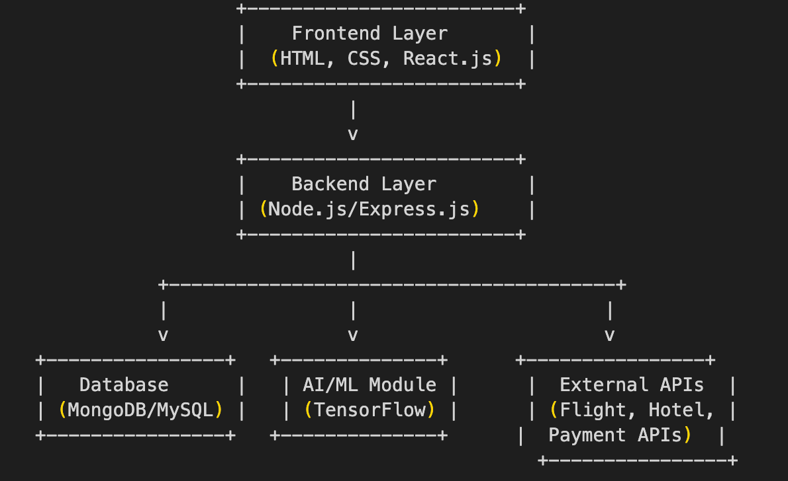
Architecture

Slide 9

Hardware/Software components
Hardware:
Smartphone/Tablet/Desktop: The website is designed to be responsive and accessible across mobile platforms, requiring users to have smartphones or tablets that support modern web browsers.
Cloud Server: The website's backend services will be hosted on cloud infrastructure such as AWS or Google Cloud, ensuring scalability, reliability, and efficient data processing.
Software:
Frontend Framework (React.js): The website is developed using React.js, a JavaScript library that enables the creation of dynamic and interactive user interfaces for seamless user experiences.
HTML5 and CSS3: These technologies are used for structuring and styling the website, ensuring a modern design and mobile responsiveness.
Backend Framework (Node.js and Express.js): The server-side logic is built using Node.js with Express.js, allowing for the creation of RESTful APIs to handle user requests and data management.
Database (MongoDB/MySQL): User data, booking information, and travel preferences are stored in a MongoDB or MySQL database, facilitating efficient data retrieval and management.
Machine Learning Libraries (Python): Python libraries such as TensorFlow or Scikit-learn are used to develop the recommendation engine, enabling personalized travel suggestions based on user behavior.
Payment Gateway APIs:
Razorpay: Integrates with Razorpay for secure payment processing, supporting a wide range of payment options, including credit/debit cards, UPI, and net banking.
PayPal Payment Gateway: Incorporates PayPal for additional payment flexibility and convenience, allowing users to pay using PayPal wallets, credit/debit cards, and net banking.
Cloud Storage: Data such as user profiles and booking histories are stored and processed securely using cloud services to ensure scalability and data integrity.

Slide 10
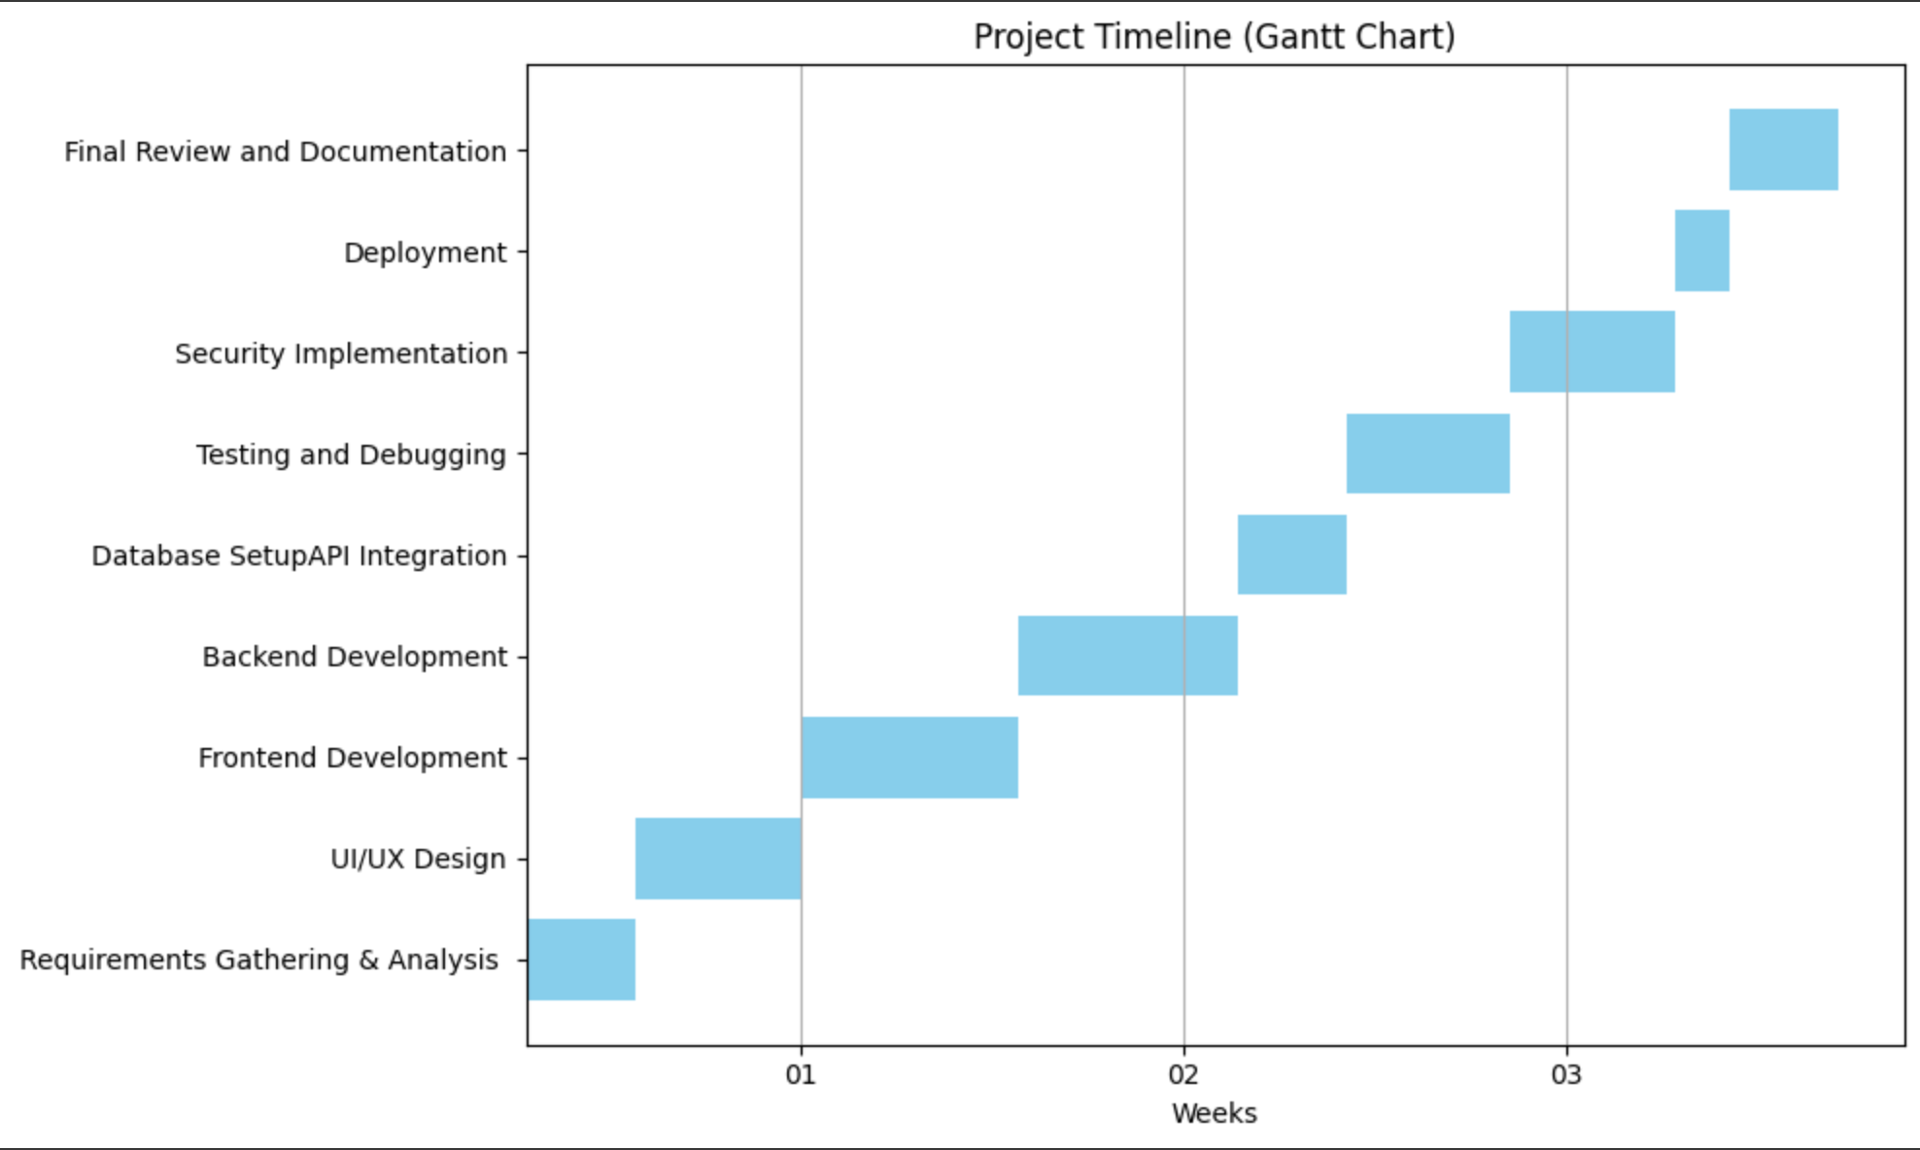
Timeline of Project

Slide 11
Outcomes / Results Obtained
Achievements
Developed an Interactive Travel Dashboard using Streamlit and Folium.
Integrated Real-Time APIs for weather and PayPal booking simulation.
Enabled Custom Itinerary Planning with budgeting and travel details.
Deployed Successfully on Streamlit Cloud for global access.
Received Positive Feedback on user experience and interface design.
Built a Scalable Framework for future expansion and feature integration.
Future Development
Continuous Expansion: Add multilingual support, AR previews, and transport APIs.
AI Personalization: Smart itinerary suggestions based on user preferences.
Enhanced Coverage: Include cultural sites, local guides, and public facilities.

Slide 12
Conclusion
The "Tourismo AI: Smart Travel & Hospitality Hub" website represents a transformative approach to travel planning by integrating various travel-related services into a single, user-friendly platform. By leveraging advanced technologies such as AI-driven recommendations and secure payment gateways, the website not only simplifies the booking process but also enhances personalization, making travel planning more efficient and enjoyable for users. With a focus on data security, user engagement, and continuous improvement, the website aims to meet the diverse needs of modern travelers while fostering a seamless experience from the initial search to the final booking. As a result, this innovative solution has the potential to revolutionize the tourism industry, empowering users with the tools and insights necessary to create memorable travel experiences tailored to their unique preferences and aspirations.

Slide 13
Github Link
https://github.com/AshmitKumar1110/Tourismo-AI-Smart-Travel-Hospitality-Hub

Slide 14
References
Zhang, X.Y., et al. (2022). "Smart Tourism Systems: Leveraging Technology for Enhanced User Experiences." Journal of Tourism Technology.
Garcia, P., et al. (2021). "AI in Travel Recommendation Systems: A Review of Applications and Future Directions." Artificial Intelligence and Tourism Review.
Brown, A. (2021). "The Rise of Digital Platforms in the Travel Industry: Opportunities and Challenges." TechTourism Quarterly.
Grönroos, L. (2020). "User-Centric Design in Travel Platforms: Enhancing Customer Satisfaction through Intuitive Interfaces." Customer Experience Studies.
Steiner, M. (2020). "Mobile Travel Apps: Functionality, Usability, and User Engagement." Mobile Computing for Travel.
Smith, J. (2021). "Destination Management Systems: Enhancing Localized Information and Services." Journal of Destination Marketing.
Kumar, R. (2019). "Payment Security in Online Travel Transactions: Challenges and Solutions." International Journal of E-commerce Research.
Morrison, C. (2018). "The Role of User-Generated Content in Travel Decision Making: An Analysis of Trust and Influence." Tourism Management Perspectives.

Slide 15

Project work mapping with SDG

Slide 16
Thank You

